Slide 1

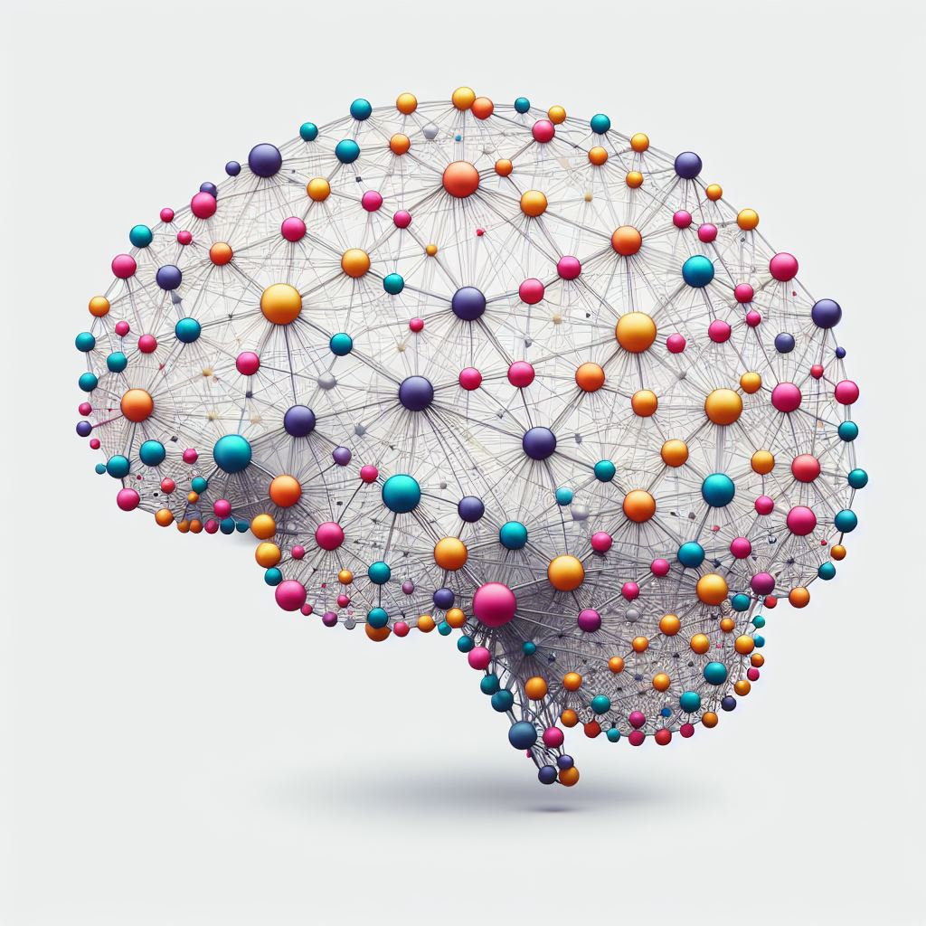
Demystifying Neural Networks
By Maajid Husain
(President @DSAC)

Slide 2
A Brief History of Neural Networks
1943
1957
1960
1965
1969
1970s

Slide 3
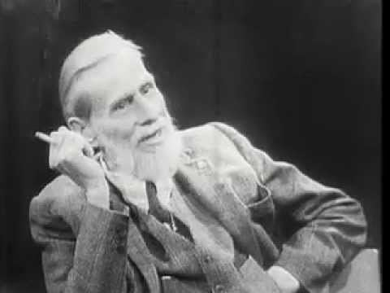
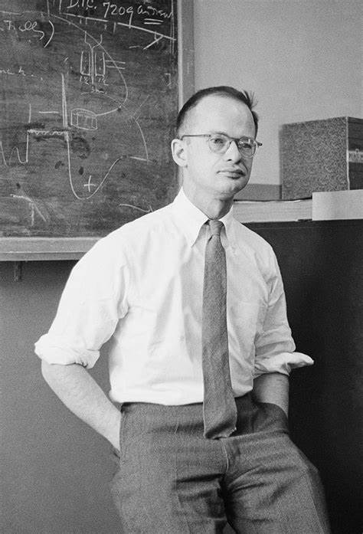
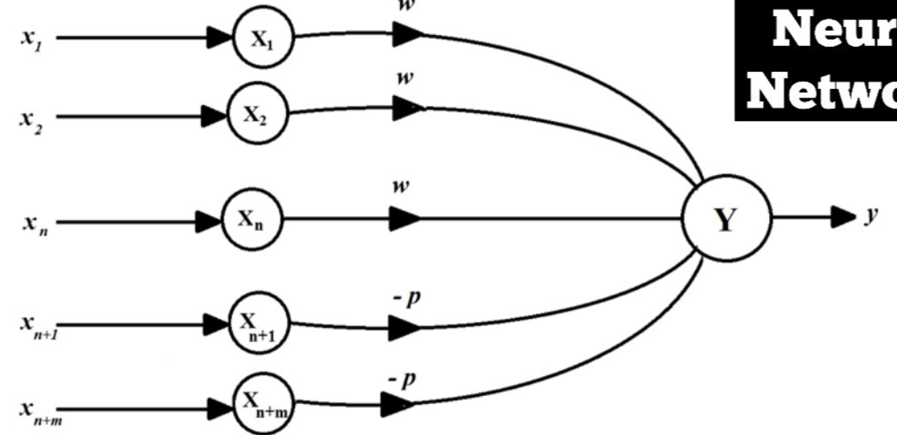
1943: McCulloch Pitts Neuron – The Beginning
Warren McCulloch and Walter Pitts introduce a mathematical model simulating how neurons work in the brain
Laid the groundwork for neural networks
1943
1957
1960
1965
1986
1987

Slide 4
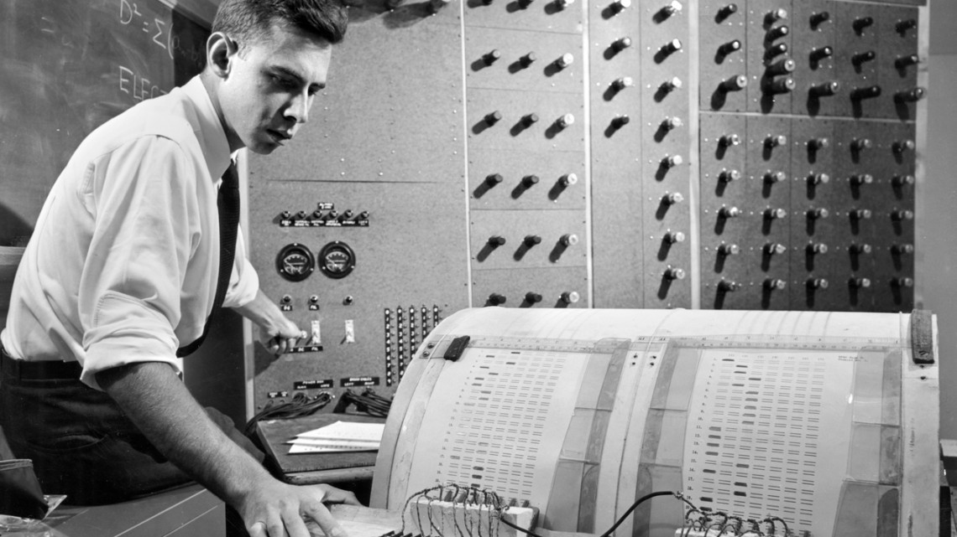
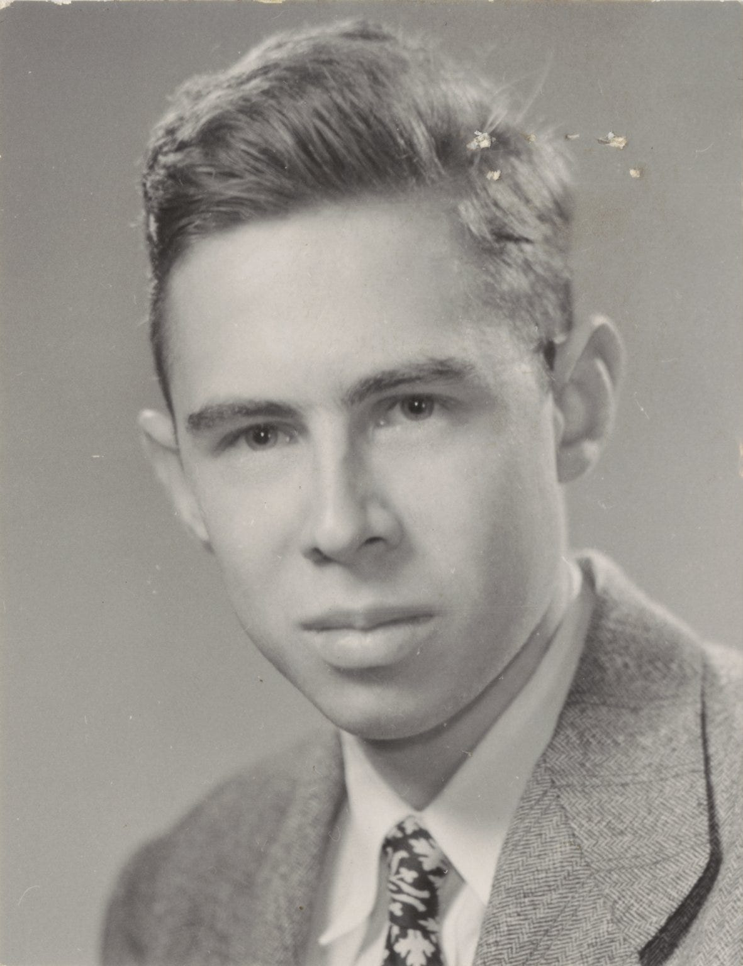
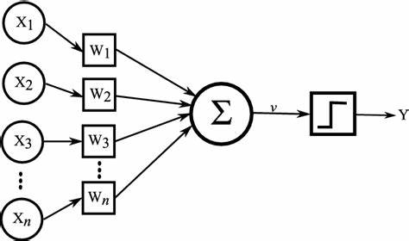
1943: Frank Rosenblatt – The Perceptron
Newer model which is a system capable of learning through successive passed inputs
Limited to linearly separable classes
1943
1957
1960
1965
1986
1987

Slide 5
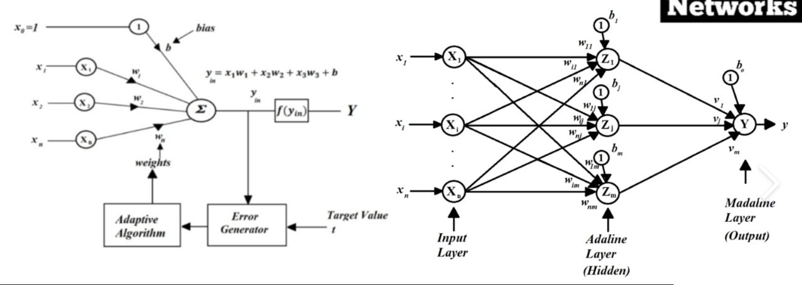
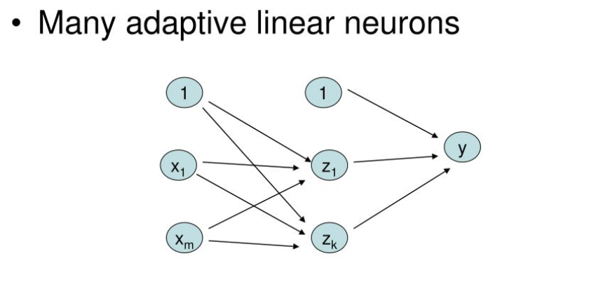
1960: ADALINE and MADALINE – First Real World Application
ADALINE – predicted binary patterns
MADALINE – reduced echo's in phone lines
Allowed researchers to see the use of neural networks
1943
1957
1960
1965
1986
1987

Slide 6
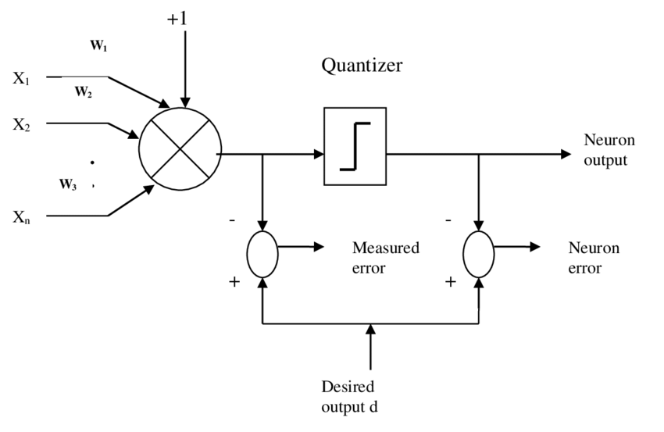
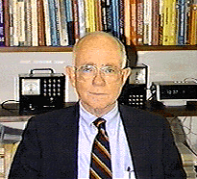
1965: Widrow & Hoff – Adjustable Weights
Developed a learning procedure for adjusting weights in a neural network
Precursor to backpropagation as we know it
1943
1957
1960
1965
1986
1987

Slide 7
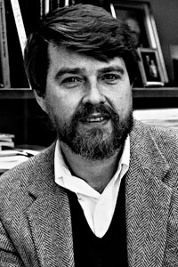
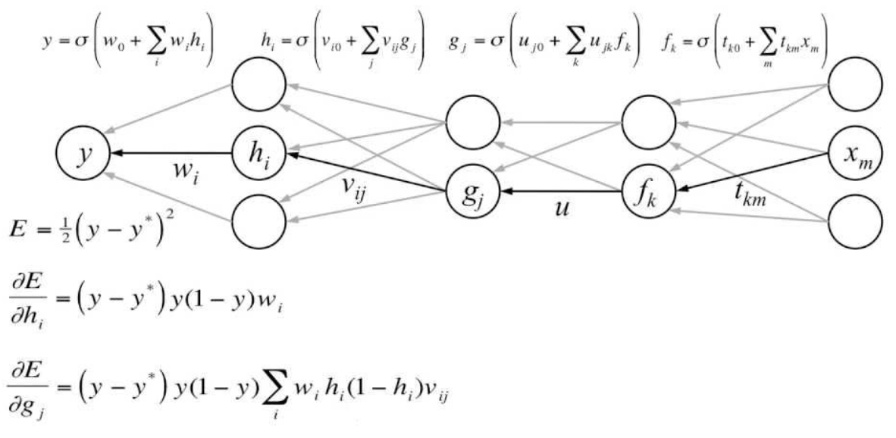
1986: David E. Rumelhart – Backpropagation
A method for training multi-layer perceptrons
Standard approach in neural networks today
1943
1957
1960
1965
1986
1987

Slide 8
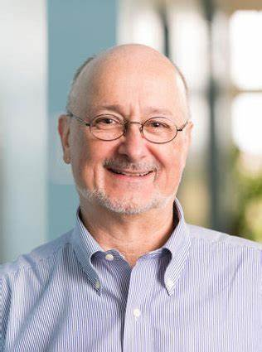
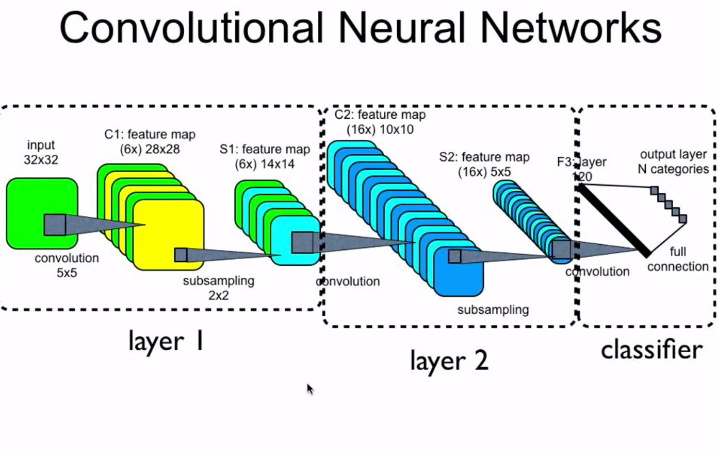
19687: Alex Waibel – CNN’s
Convolutional Neural Networks – shift invariance through weight sharing and backpropagation
Used especially in image analysis today
1943
1957
1960
1965
1986
1987

Slide 9
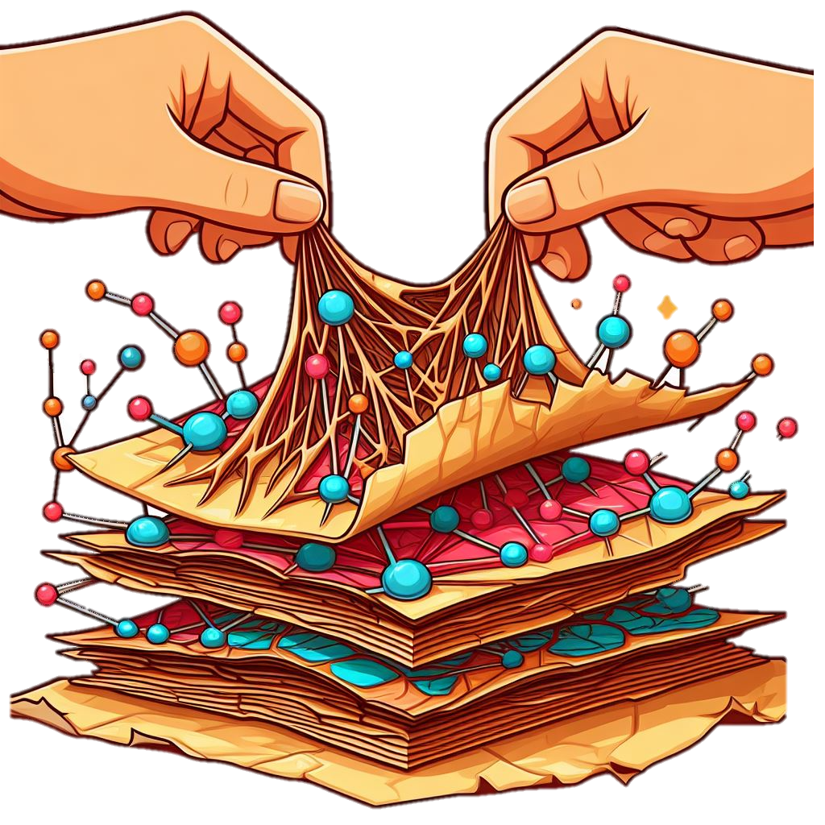
Neural Networks Unveiled

Slide 10
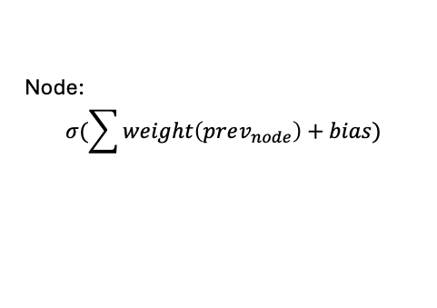
Anatomy of a Neural Network
Edge:
- Each edge carries a weight
Node:
$$σ(\sum{weight\left(prev_{node}\right)}+bias)$$
Activation function:
- More later
Input Layer
Hidden Layer 1
Hidden Layer 2
Output Layer
Feed Forward: using neural network
Back Propagation: building neural network

Slide 11
Input Layer
Hidden Layer 1
Hidden Layer 2
Output Layer
Can be one or more nodes
Number of Hidden Layers:
Simple problems: 1
Deep Learning: networks with three or more hidden layers
Number of neurons per layer:
Generally: between the number of input nodes and output nodes
Too many neurons → overfitting
Can be one or more nodes

Slide 12
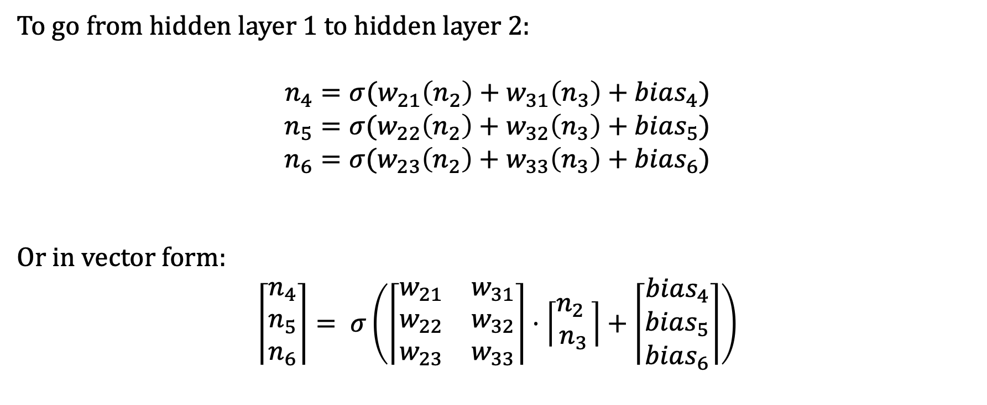
Nodes: Sample Transition
To go from hidden layer 1 to hidden layer 2:
$$n_{4}={σ(w}_{21}\left(n_{2}\right)+w_{31}\left(n_{3}\right)+bias_{4})$$
$$n_{5}={σ(w}_{22}\left(n_{2}\right)+w_{32}\left(n_{3}\right)+bias_{5})$$
$$n_{6}={σ(w}_{23}\left(n_{2}\right)+w_{33}\left(n_{3}\right)+bias_{6})$$
Or in vector form:
$$\left\lceil \begin{matrix}n_{4} \\ n_{5} \\ n_{6}\end{matrix}\right\rceil = σ\left(\left\lceil \begin{matrix}w_{21} & w_{31} \\ w_{22} & w_{32} \\ w_{23} & w_{33}\end{matrix}\right\rceil ⋅\left\lceil \begin{matrix}n_{2} \\ n_{3}\end{matrix}\right\rceil +\left\lceil \begin{matrix}bias_{4} \\ bias_{5} \\ bias_{6}\end{matrix}\right\rceil \right)$$
n4
w21
n2
w22
w23
n5
w31
w32
n3
w33
n6
Input Layer
Hidden Layer 1
Hidden Layer 2
Output Layer

Slide 13
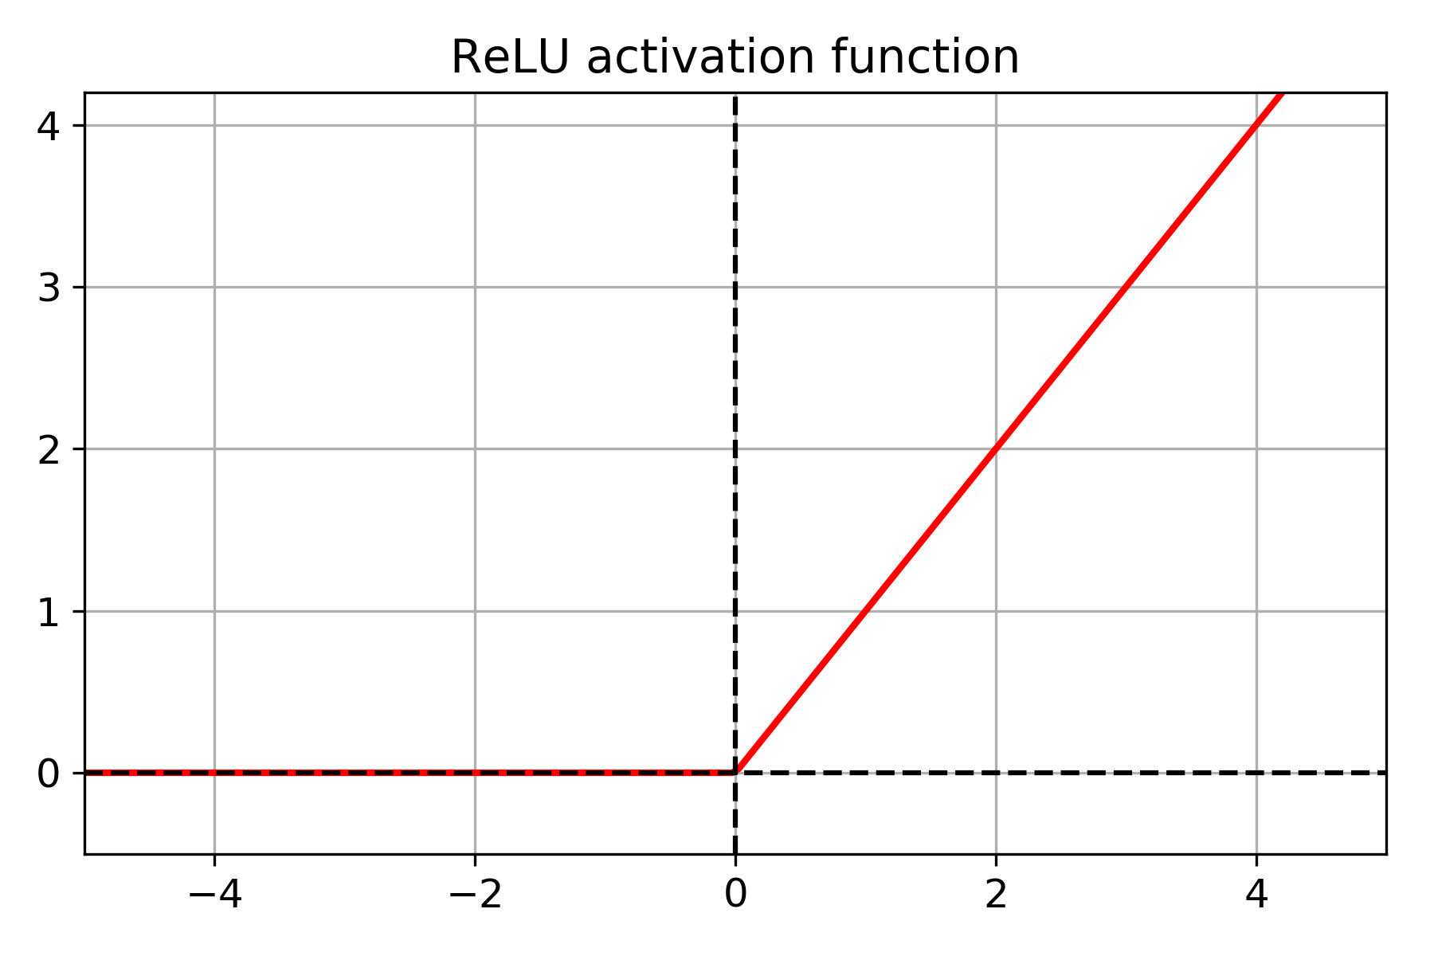
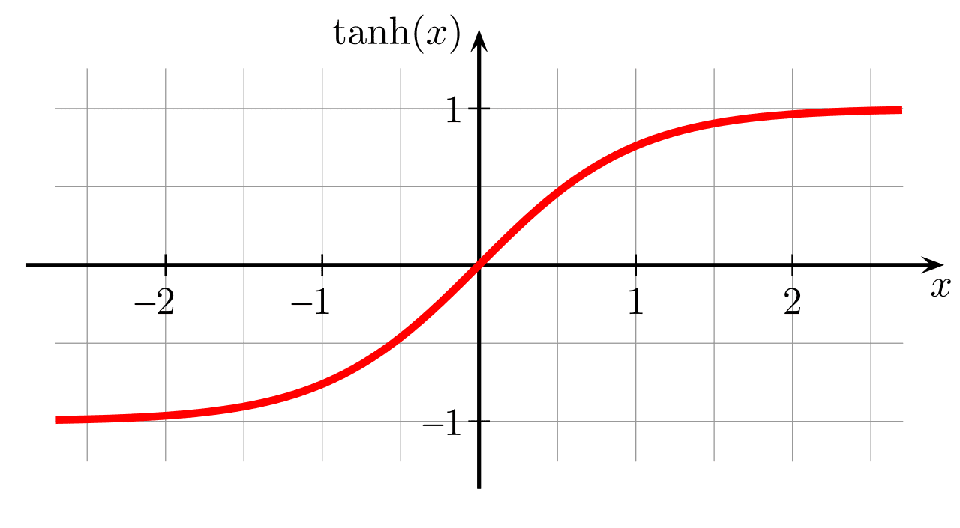
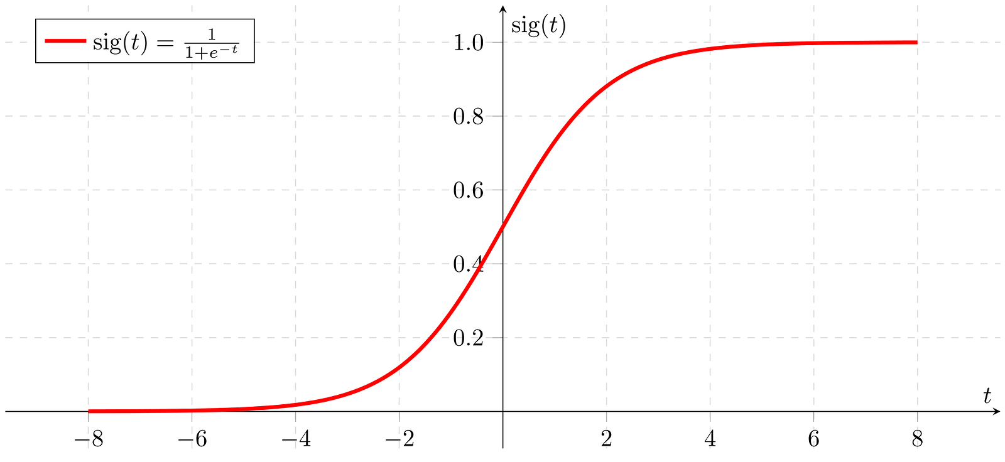
Activation Function
What are they for:
Introduce non-linearity → allows the network to learn more complex representations of the data
Without them → would act like a linear regression model
Common Activation Functions
Input Layer
Hidden Layer 1
Hidden Layer 2
Output Layer
sigmoid | maps inputs to 0 || 1 | used in classification
tanh | maps inputs in range between -1 and 1 | often used in hidden la
ReLU | outputs directly if positive, otherwise outputs 0 | most popular due to performance

Slide 14
Initialize Weights
Start with initial weights (random)
Forward Pass
Feed input data through network and compute predicted output
Calculate the weighted sum of inputs
Calculate Loss
Calculate mean squared error
Quantifies how far the predicted values are from actual
Backward Pass
Gradient Calculation
Update Weights
compute gradient of loss with respect to weights
Derive each weight using chain rule
For each weight compute partial derivate of the loss with respect to that weight
Matrix operations to calculate gradients
Adjust weights based on gradient & learning rate
Usual update rule: $new_{weight}=old_{weight}−learning_{rate}∗gradient$
Usual update rule: 𝑛𝑒𝑤_𝑤𝑒𝑖𝑔ℎ𝑡=𝑜𝑙𝑑_𝑤𝑒𝑖𝑔ℎ𝑡−𝑙𝑒𝑎𝑟𝑛𝑖𝑛𝑔_𝑟𝑎𝑡𝑒∗𝑔𝑟𝑎𝑑𝑖𝑒𝑛𝑡
Backpropagation
Repeat until loss is
minimized
Input Layer
Hidden Layer 1
Hidden Layer 2
Output Layer

Slide 15
Beyond Gradient Descent: Other Optimizations
Stochastic Gradient Descent
A variant of gradient descent that updates weights using a subset of data
Pros: reduces computation time and can escape local minima due to data noise
Cons: Variability = more instability in convergence path → needs carefully tuned learning rates
Momentum
Concept of inertia into SGD considering past updates when considering update
Pros: helps accelerate SGD inn the relevant direction and dampens oscillations
Cons: Introduces an additional hyperparameter that needs to be tuned
Adagrad (Adaptive Gradient Algorithm)
Adjusts the learning rate for each weight individually, based on historical sum of the squares of the gradients
Pros: Great for sparce data and eliminates need to manually tune learning rate
Cons: Can lead to halting learning early

Slide 16
RMSprop (Root Mean Square Propagation)
Modifies Adagrad by using moving average of squared gradients to adapt the learning rate
Pros: generally faster convergence than Adagrad and SGD
Cons: Requires tuning of learning rates and not immune to saddle point challenges
Adam, (Adaptive Moment Estimation)
Combines ideas from momentum and RMSprop maintaining exponentially decaying average of past gradients and squared gradients
Pros: Computationally efficient, requires little tuning of learning rate
Cons: Can converge at suboptimal solutions in certain cases
Nadam (Nesterov-accelerated Adaptive Moment Estimation)
Like Adam but incorporates Nesterov momentum which anticipates gradient direction to improve convergence
Pros: Leads to faster convergence and improved performance over Adam sometimes
Cons: Sensitive to hyperparameter settings

Slide 17

Building blocks of deep learning

Slide 18
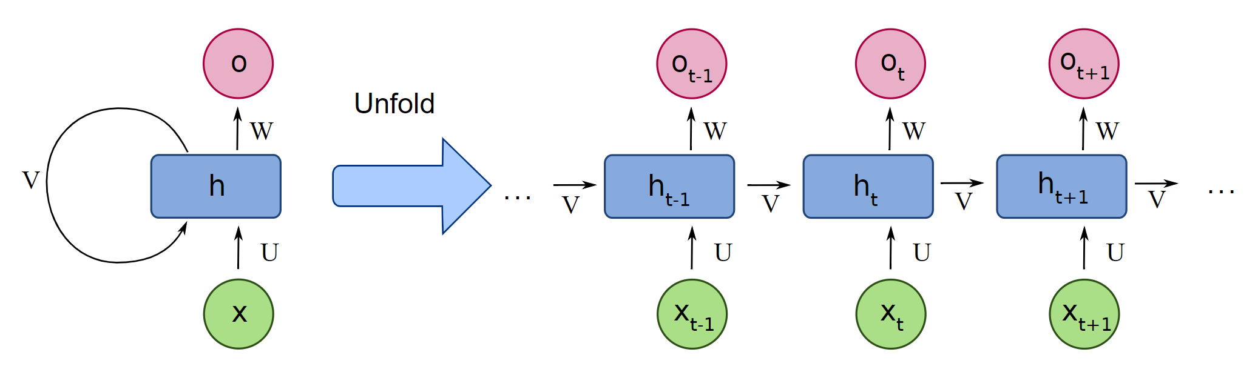
RNN: Recurrent Neural Networks
What are they?
Uses temporal / time series data
Able to keep a memory of past stages
Memory, however, is lost after several time intervals
What's relationship between Linear Regression & Recurrent Neural Networks - Cross Validated (stackexchange.com)

Slide 19


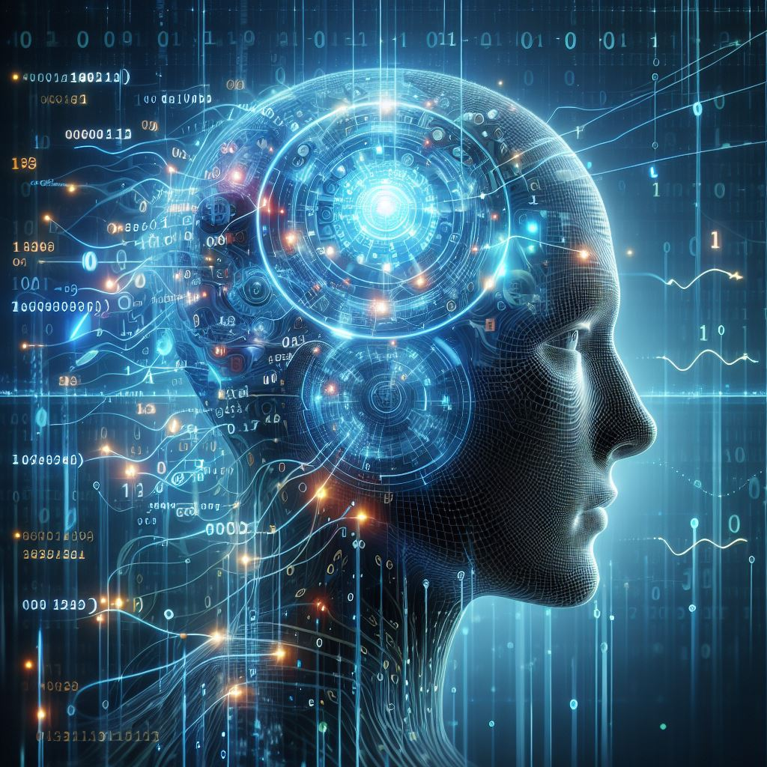
RNN: Use Cases
Music Generation
Text Generation
Language Translation
Can learn temporal dynamics of music
Great for sequence prediction in music
Able to maintain thematic context
Character and word level predictions
Encoder – decoder
Bidirectional RNNS allow for efficient translation

Slide 20
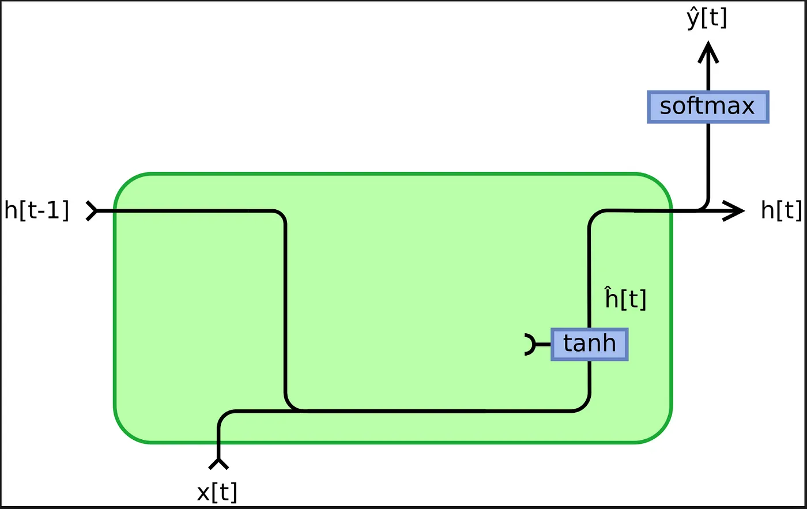
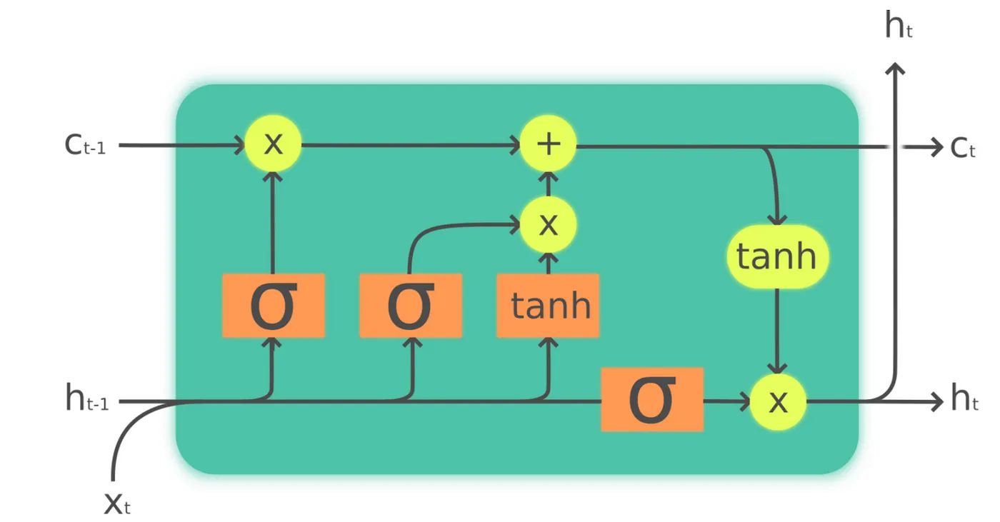
Long Short-Term Memory Neural Networks (LSTM RNN)
Able to hav elonger memory time than an RNN
Retains information for more time iterations than RNN’s normally do
Uses finely tuned activation functions to pass information through time iterations
Normal RNN example
LSTM RNN example
Deep Learning: Recurrent Neural Networks | by Pedro Borges | deeplearningbrasilia | Medium

Slide 21

CNN: Convolutional Neural Networks
Layer | Layer Function
Convolution (CONV) | Conv layer detect features
Pooling (POOL) | Pool layers reduce dimensionality
Fully Connected (FC) | FC layers make prediction
This Photo by Unknown Author is licensed under CC BY-NC

Slide 22
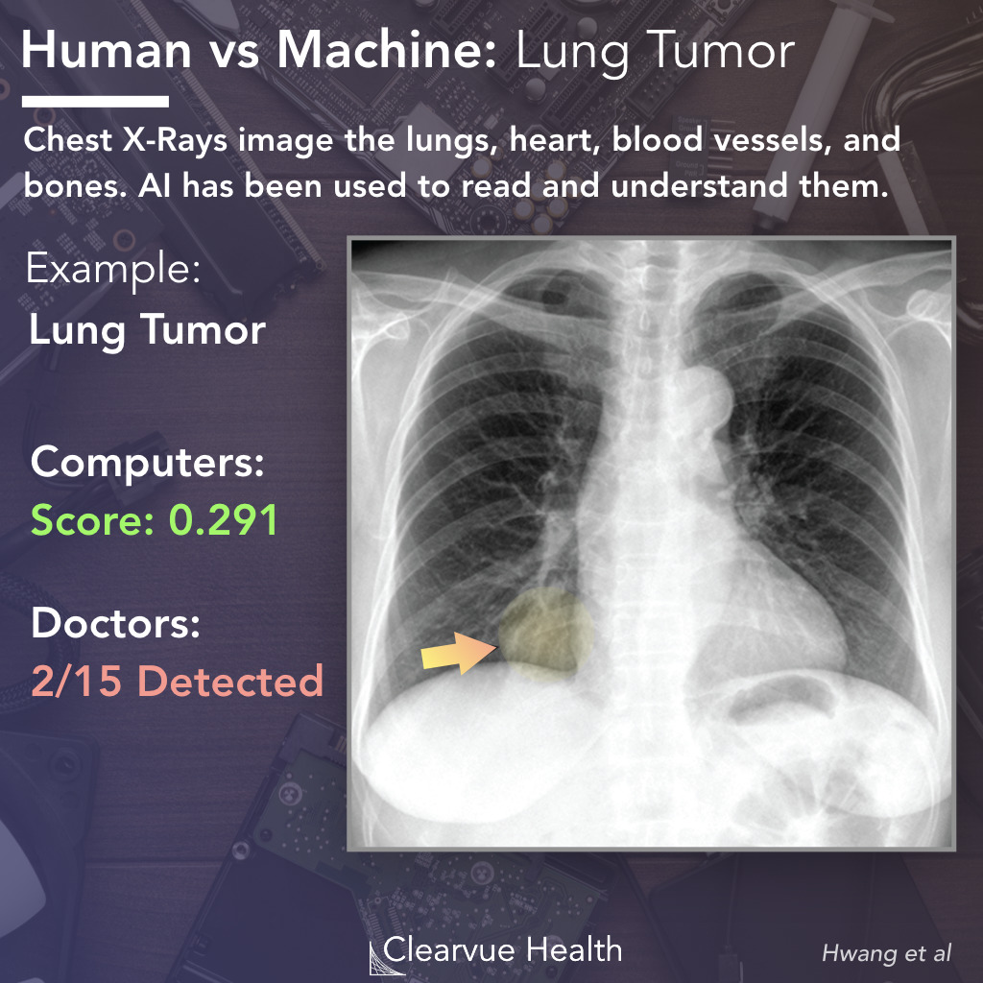


CNN: Use Cases
Medical Imaging Classification
Automated surveillance
Sports analytics
X-ray AI assistants
CT Scan check
Automated checks with doctor approval
Facial recognition
Facial sentiment analysis
Identify fraud cases
Player optimization
Injury prevention
Technique analysis
Pose estimation

Slide 23
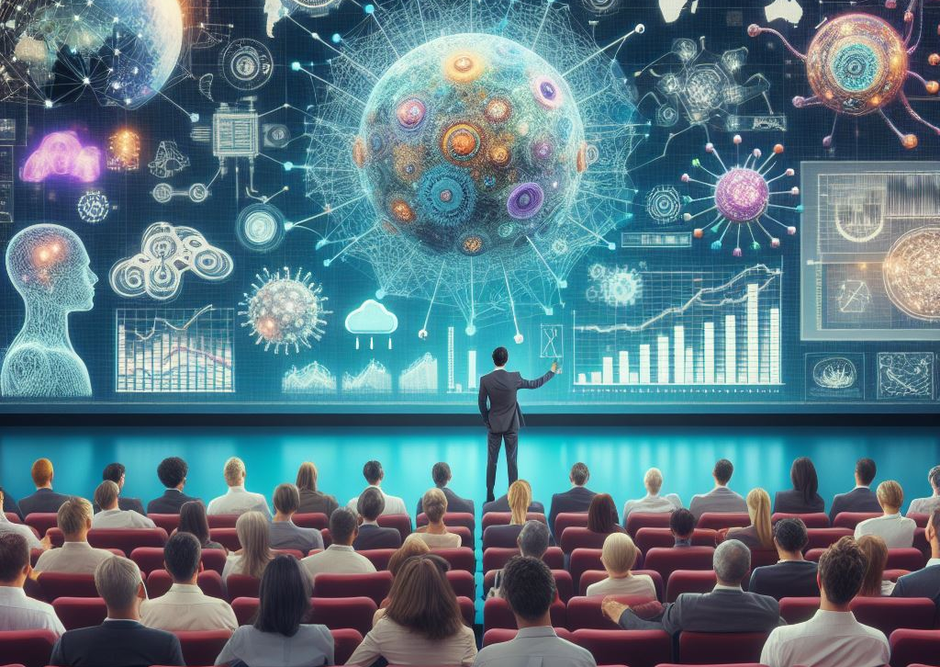
Real world Uses for Neural Networks

Slide 24

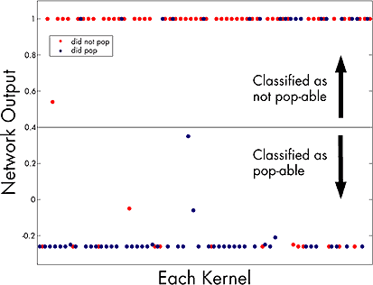
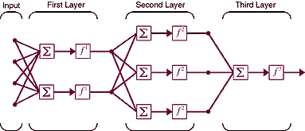
Finding only Poppable Popcorn Kernels
Researchers trained a model to identify which popcorn kernels are “likely to pop” and which are not

Slide 25

Coding Activity Time

Slide 26
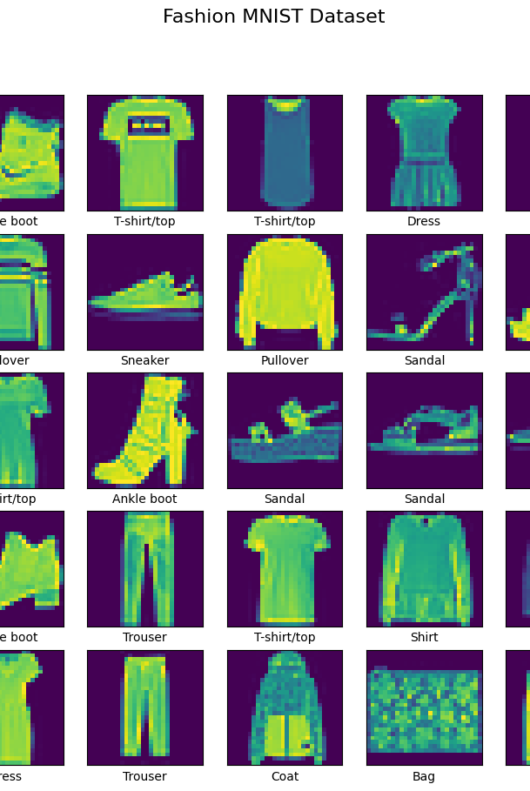

Task: Optimize model to identify items of clothing

Slide 27
References
https://www.mathworks.com/company/technical-articles/neural-networks-provide-solutions-to-real-world-problems-powerful-new-algorithms-to-explore-classify-and-identify-patterns-in-data.html
https://stats.stackexchange.com/questions/343078/whats-relationship-between-linear-regression-recurrent-neural-networks
https://www.youtube.com/watch?v=TLLqsEyt8NI
https://stanford.edu/~shervine/teaching/cs-230/cheatsheet-convolutional-neural-networks
https://cs.stanford.edu/people/eroberts/courses/soco/projects/neural-networks/History/history1.html
https://imgbin.com/png/PdXeqQi9/deep-learning-machine-learning-artificial-neural-network-computer-science-convolutional-neural-network-png

